Slide 1

Chess and Economic Development
Sam Campbell

Slide 2
Background
Personal Interest
Popularization of Chess in the U.S.
Studies on Sports and Economics
Pre-Computing Age

Slide 3

FIDE Chess Ranking Data
Old website build
Subsections for Blitz, Rapid, Standard
GitHub
Clean and Combine Standard Rankings from 2001-2005

Slide 4
Economic Development Data
World Bank Economic Indicators
GDP per capita, Unemployment, Real Interest Rates

Slide 5



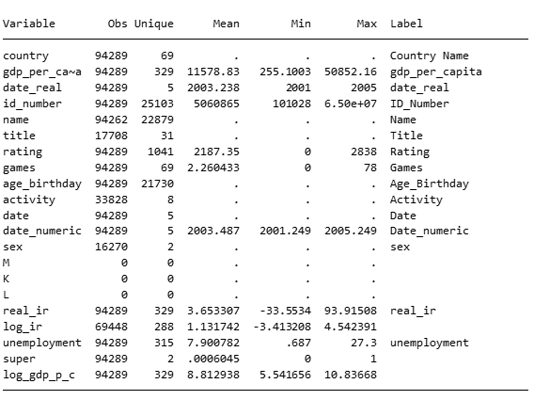
Base Data

Slide 6
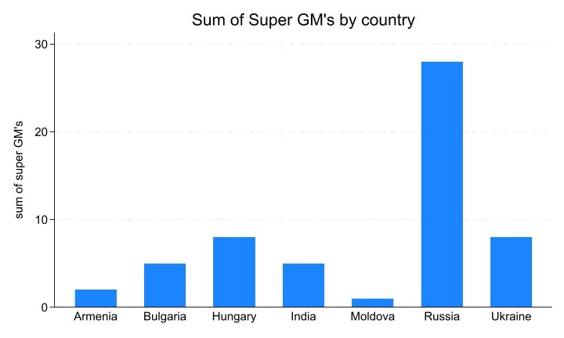
Where are the Top Players From? (2001-2005)

Slide 7
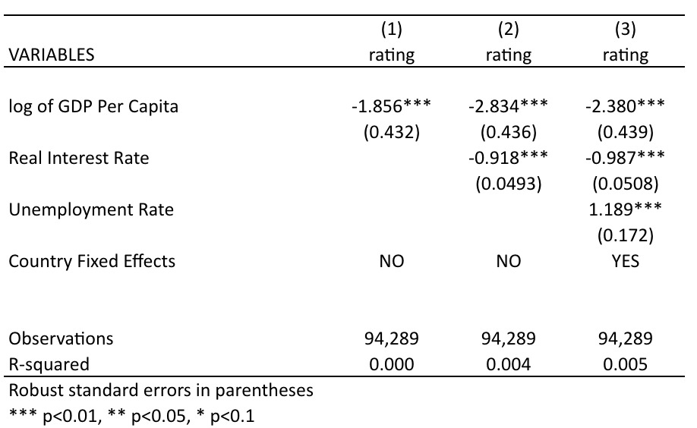
One-Way Fixed Effect Regression

Slide 8
Implications for Stakeholders
Chess as a low barrier to entry activity
Promising for Nations looking to improve their Chess programs
Would the results stay the same today? (ex: Neimann v.s. Carlsen)

Slide 9
Ethical, Legal, and Societal Implications
Non-causal and no reverse causality (hopefully)
Cultural shifts and nationwide Chess improvement
Further Research

